Slide 1

COI Presentation
Insurgency in Manipur
- Varun Khadayate A016

Slide 2
1. ORIGIN of the insurgency in Manipur in 1960’s and 70s. 2. major groups leading the insurgency 3. relation of insurgency in Manipur with Nagaland

Slide 3
1. ORIGIN of the insurgency in Manipur in 1960’s and 70s.

Slide 4
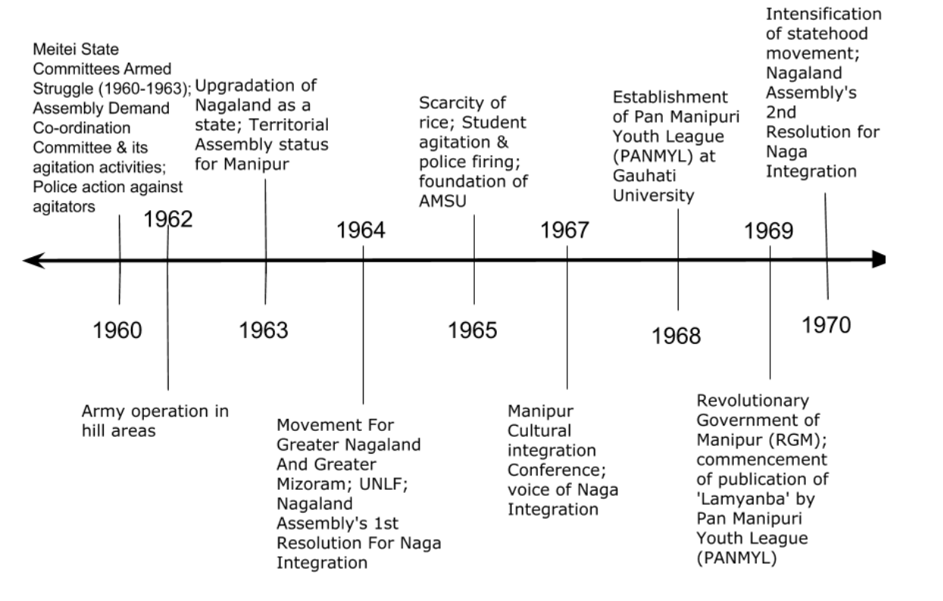

Slide 5
2. major groups leading the insurgency

Slide 6
Major groups
UNLF
PLA
PREPAK
KCP
Student organization

Slide 7
3. relation of insurgency in Manipur with Nagaland

Slide 8
Kuki Insurgency
Nagalim and Kuki Insurgency
The Kuki National Army (KNA) was formed in 1958
address the interests of Kukis
Naga-Kuki Clashes
Naga-Kuki clashes erupted in 1992-94
September 13, 1993 “black day”
Kuki-Zomi clashes in 1997-98
Important Implications
The relevance of Kukiland in the backdrop of the Naga non-territorial agreement.
The viability of opposition by the United Naga Council for the creation of Sadar Hills as a district.
The consequences of the existence of Kuki SoO designated camps on closure of NSCN (IM) “Taken-Note-Off camps”.

Slide 9
Meitei Insurgency
Background
origin in Meitei revivalism
started in 1930
Nagalim and Its Relation
origins to the foundation of UNLF on November 24, 1964
PLA in 1978
numerous other groups were formed primarily in the Imphal valley region
June 14, 2001
ceasefire between NSCN(IM) and the Centre
led to the eruption of an upsurge among the Meiteis
Important Implications
Relevance of the demand for sovereign Manipur and continuation of insurgency.
The need to engage with Meitei Leaders like UNLF Chief Raj Kumar Meghan in the peace process in order to progress towards peace in Manipur.

Slide 10
Thank You

